Slide 1
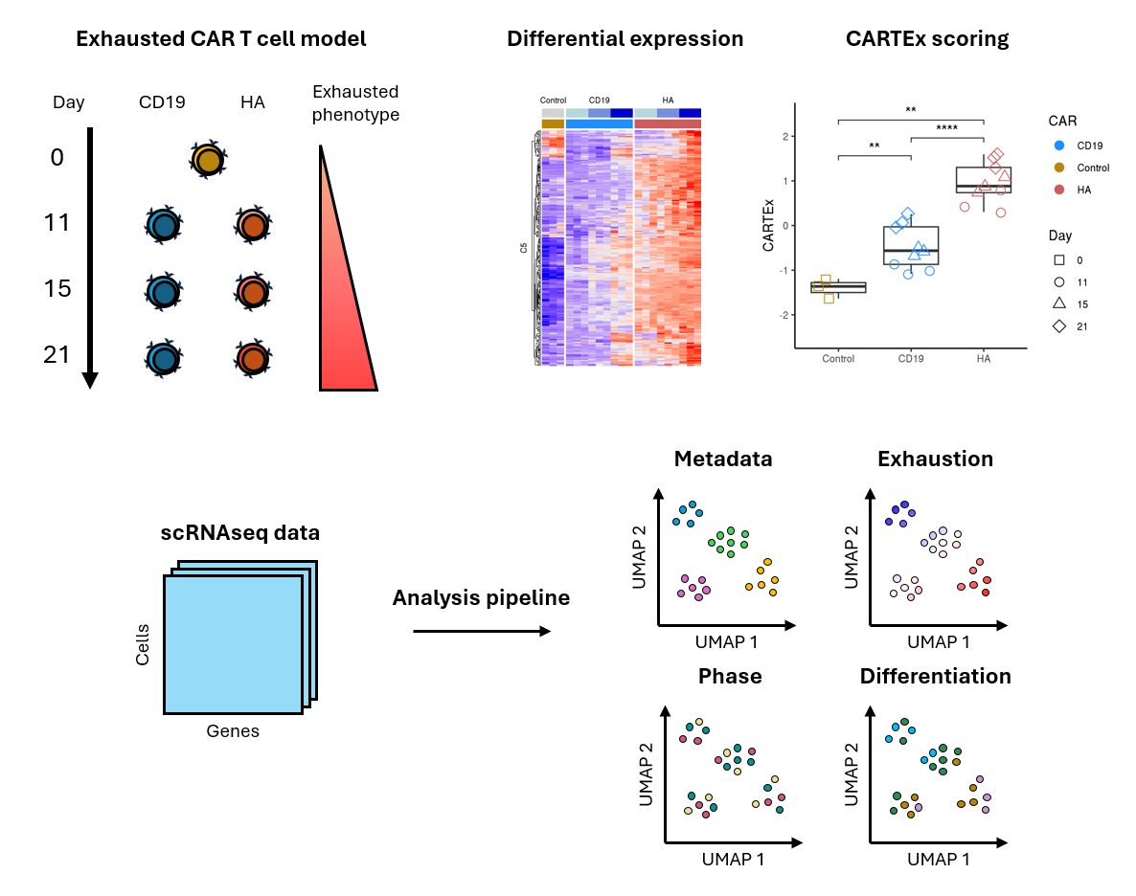
Development of transcriptional signature and scoring of T cell exhaustion from tonically signaling CAR T cells
Graphical abstract

Slide 2
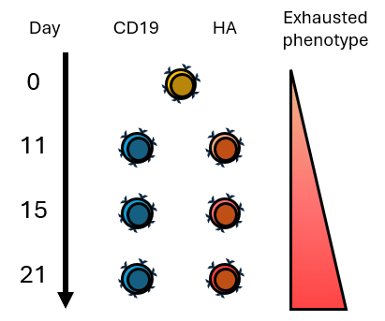
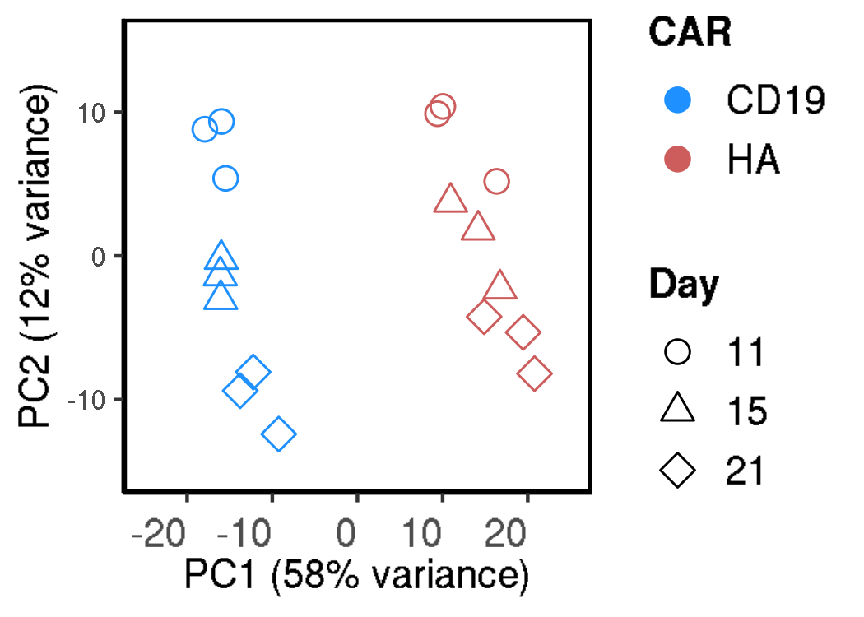
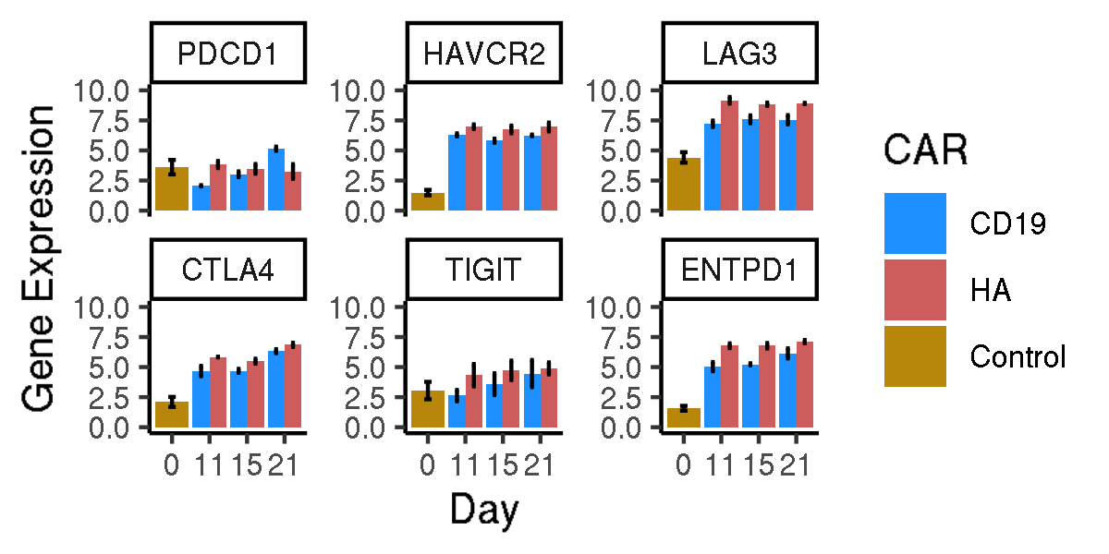
Evaluating CD19 vs HA CAR T cells
Bulk RNA sequencing of sorted functional and exhausted CD8+ CAR T cells across 21 days
Functional vs exhaustion-prone CAR
Principal components
Canonical markers of exhaustion
Notes:
Hello world

Slide 3
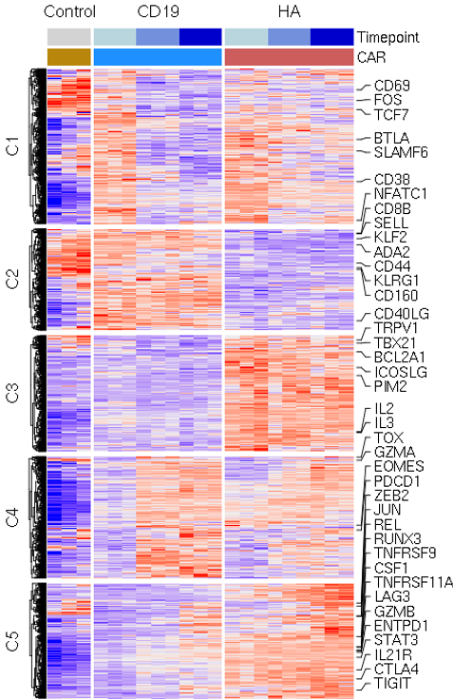
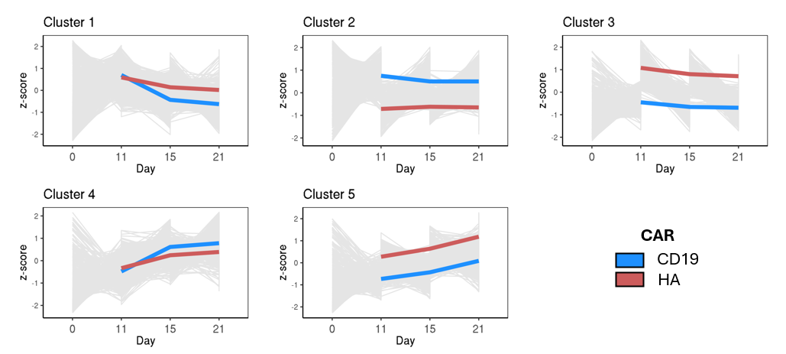
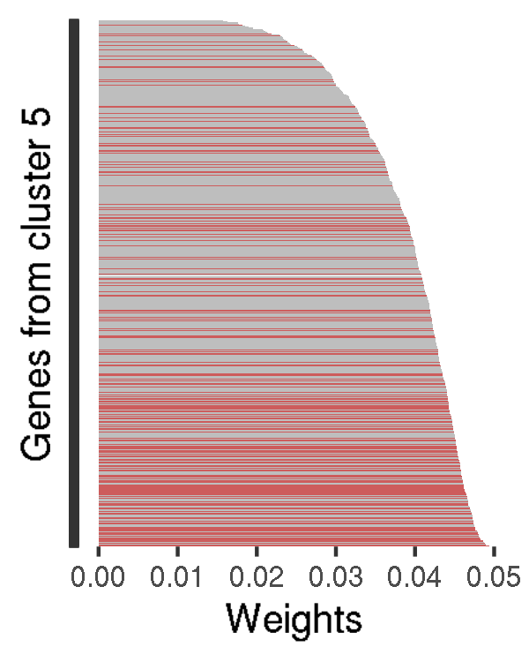
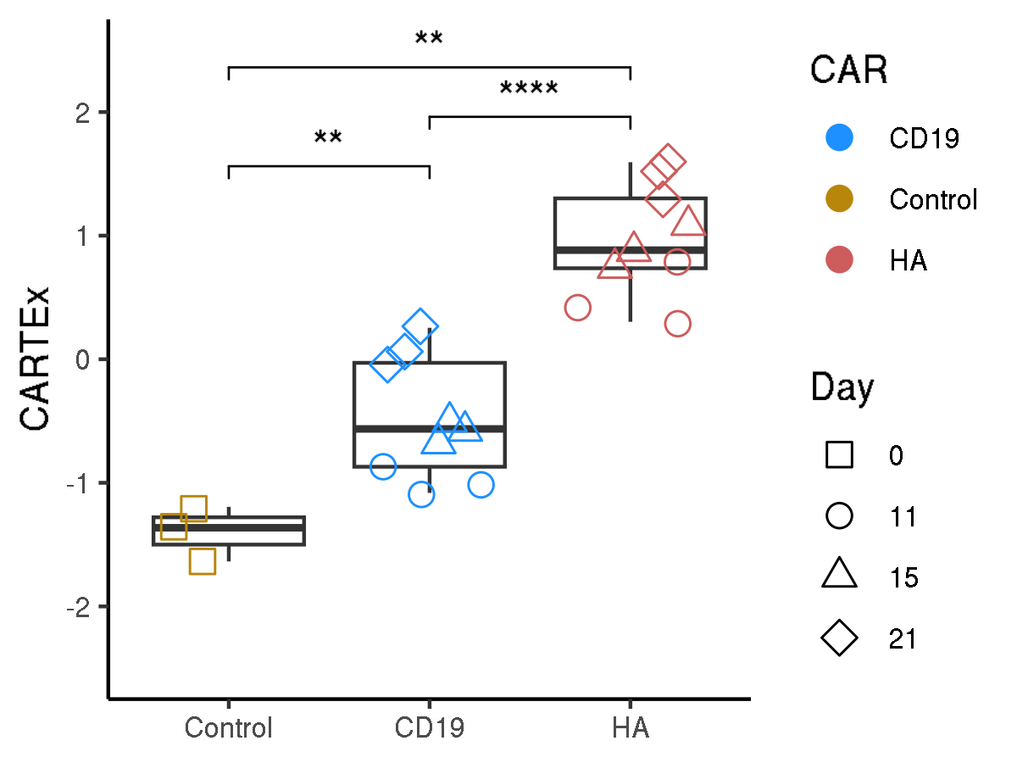
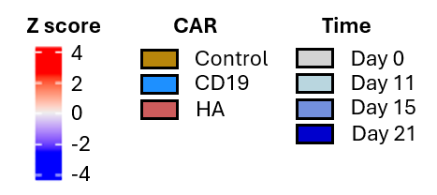
Bulk RNA sequencing of sorted functional and exhausted CD8+ CAR T cells across 21 days
ABC XYZ
Heatmap of gene expression
Clusters of gene expression
Genes of highest variance
CARTEx score
Notes:
Hello world

Slide 4
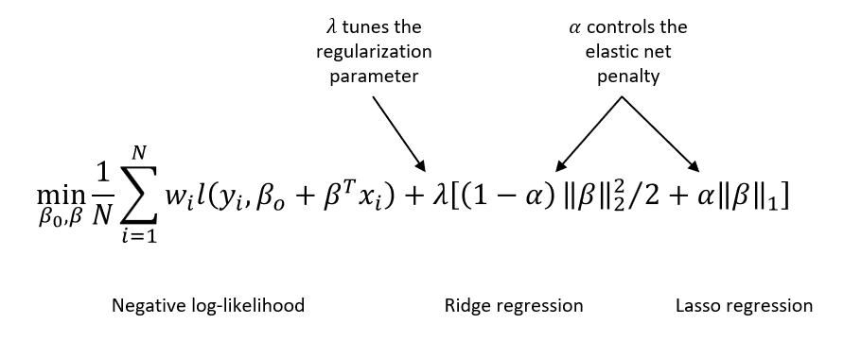
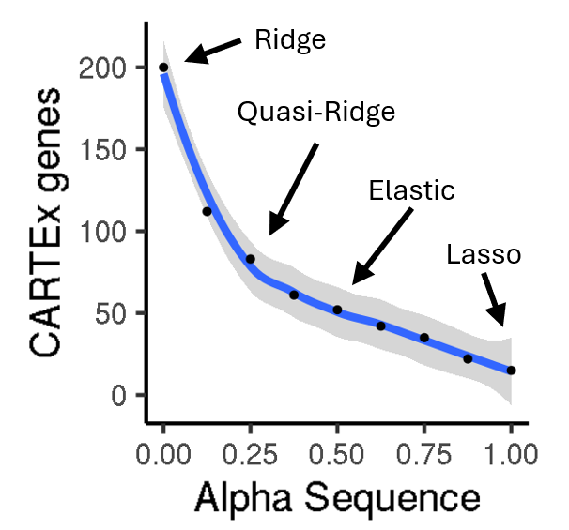
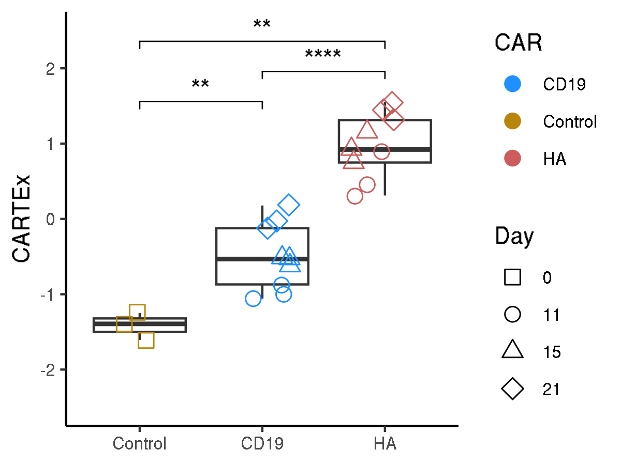
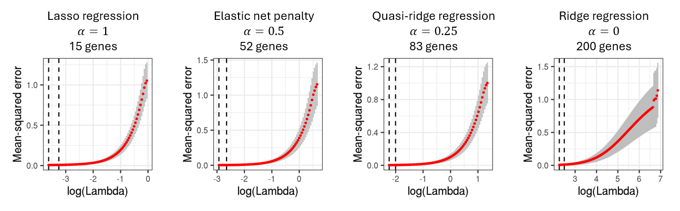
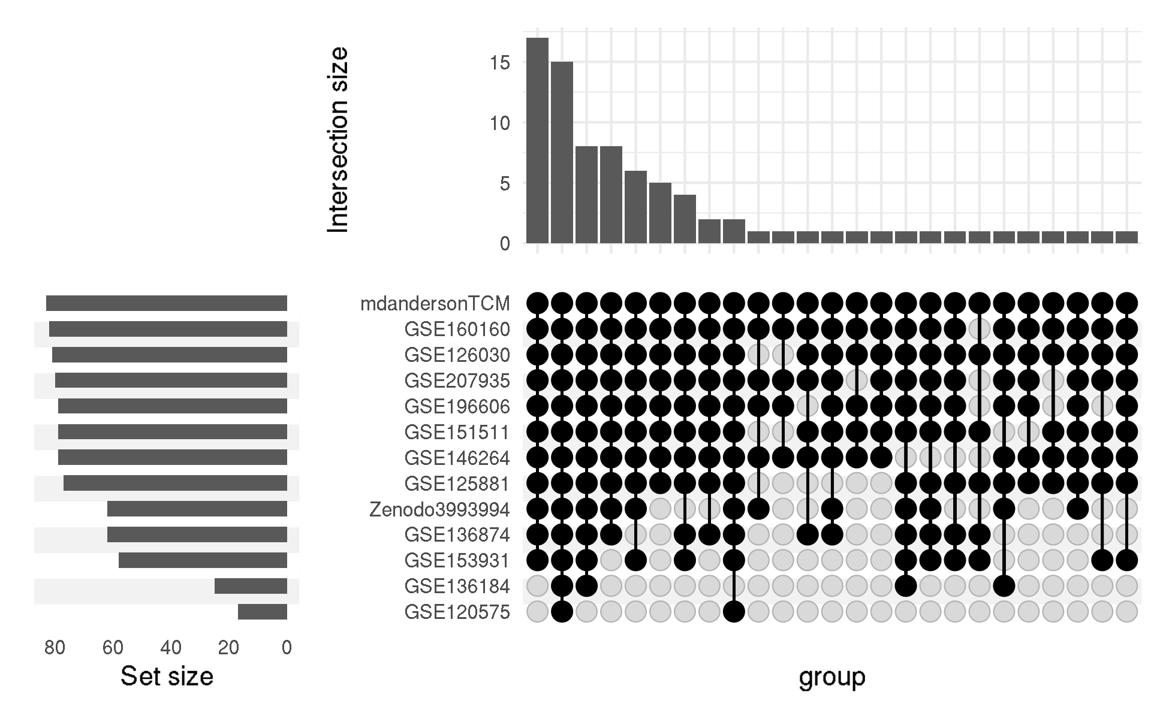
CARTEx refinement using glmnet
Regression with generalized linear models
Refinement of CARTEx signature
CARTEx scores
Representation of 84 CARTEx genes
Notes:
Hello world

Slide 5
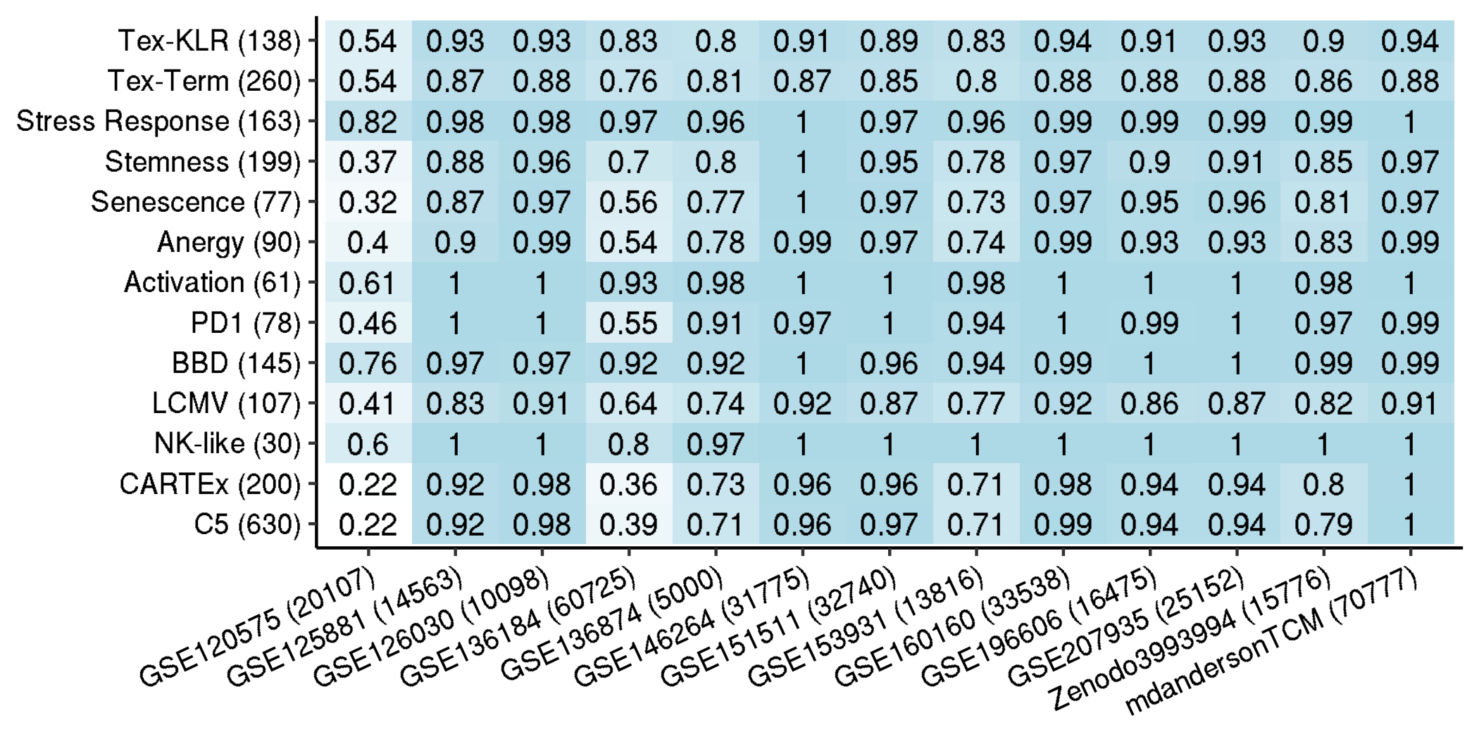
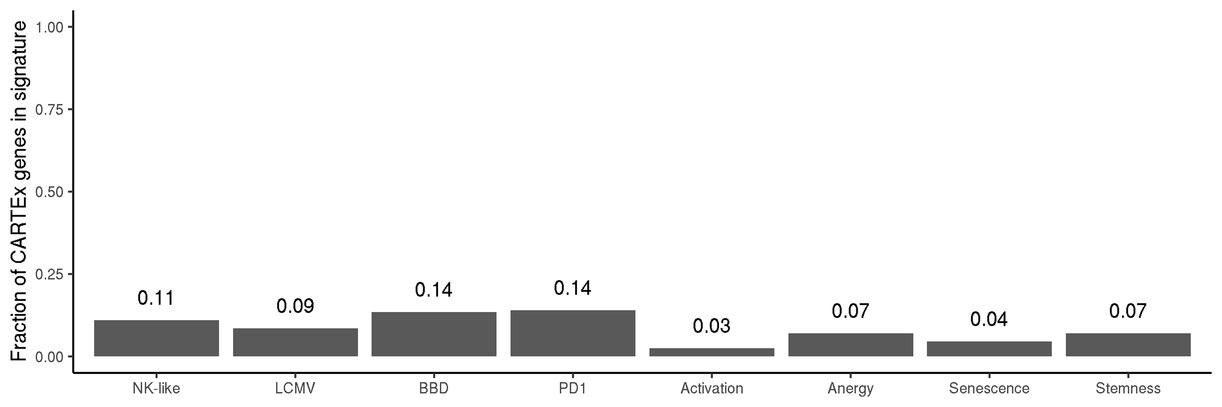
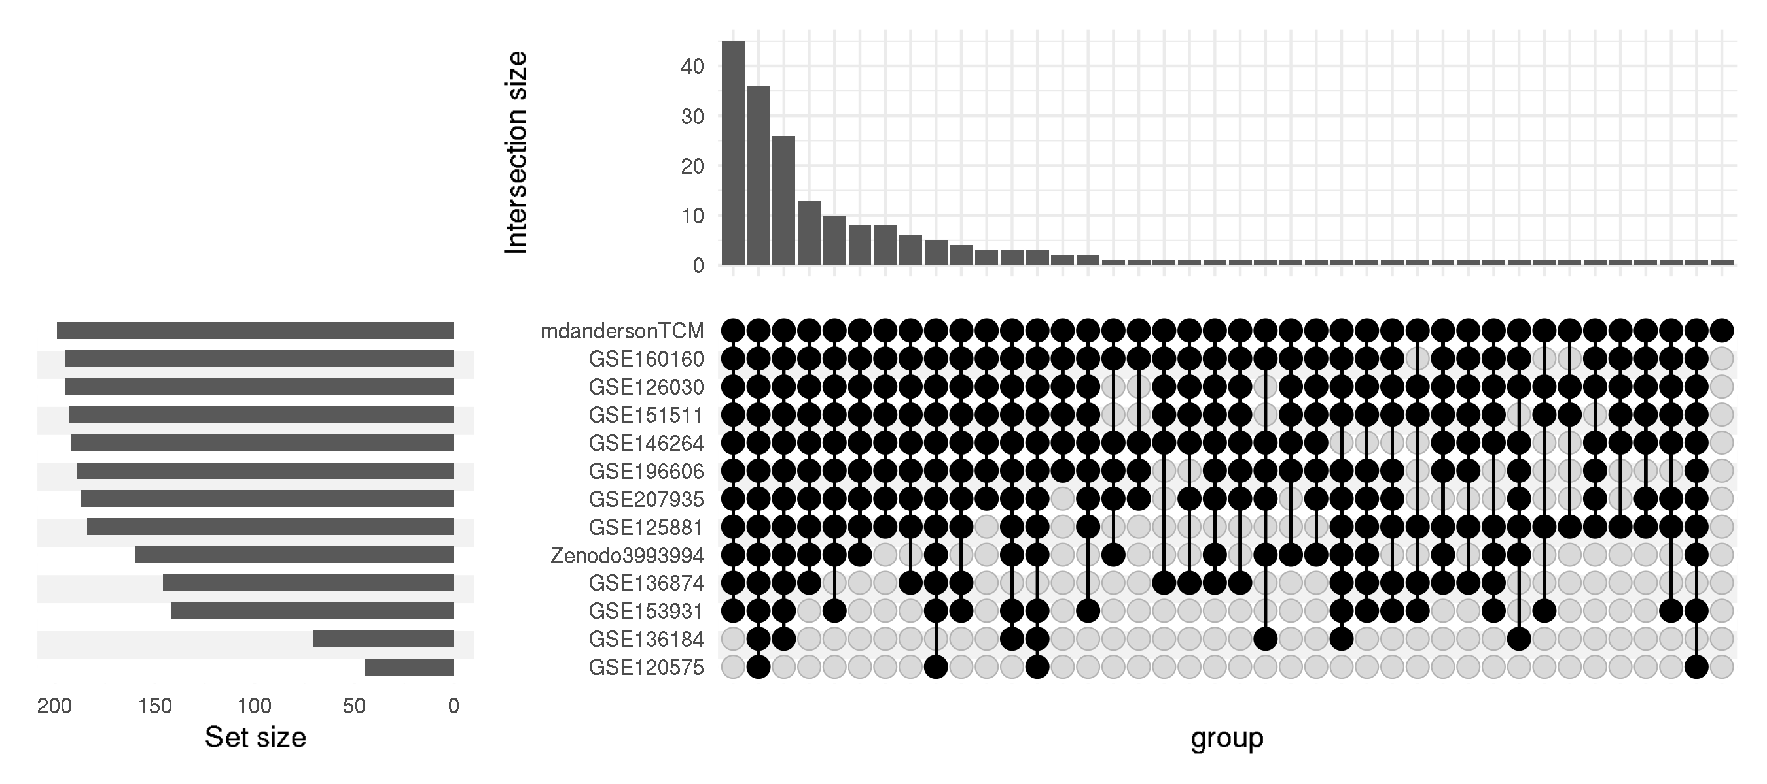
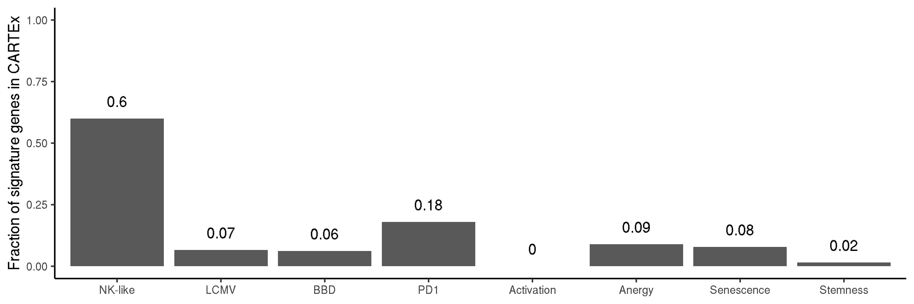
Dissecting the bulk-RNAseq experiment with signatures
Contextualizing the CARTEx signature
Representation of signatures
Fraction of CARTEx genes represented in each signature
Representation of CARTEx (200)
Fraction of signature genes represented in CARTEx
Notes:
Hello world

Slide 6
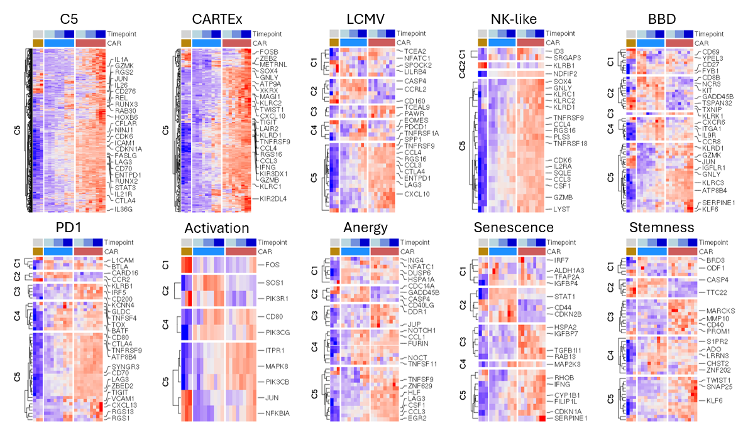
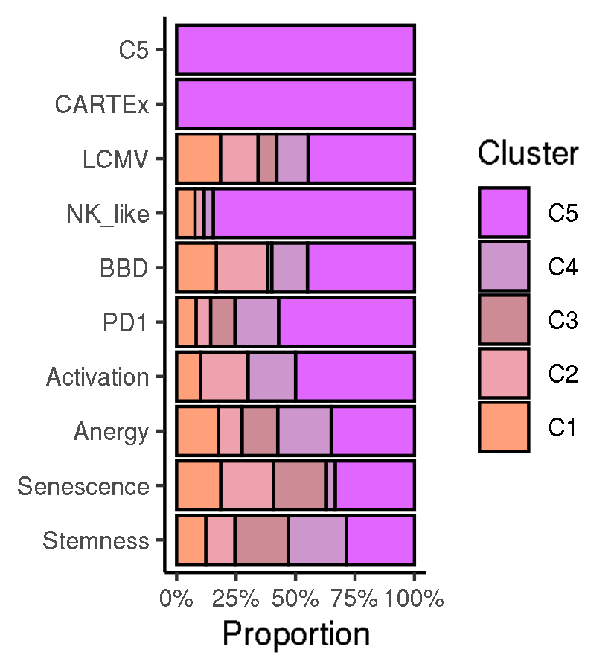
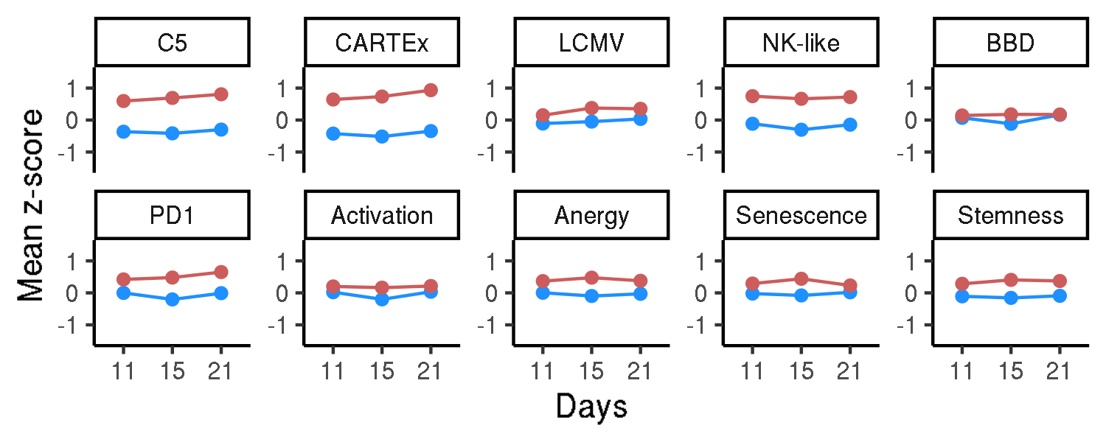
Dissecting the bulk-RNAseq experiment with signatures
Contextualizing the CARTEx signature
Heatmap of gene expression subset by signature
Cluster representation by signature
Mean gene expression by signature
Notes:
Hello world

Slide 7
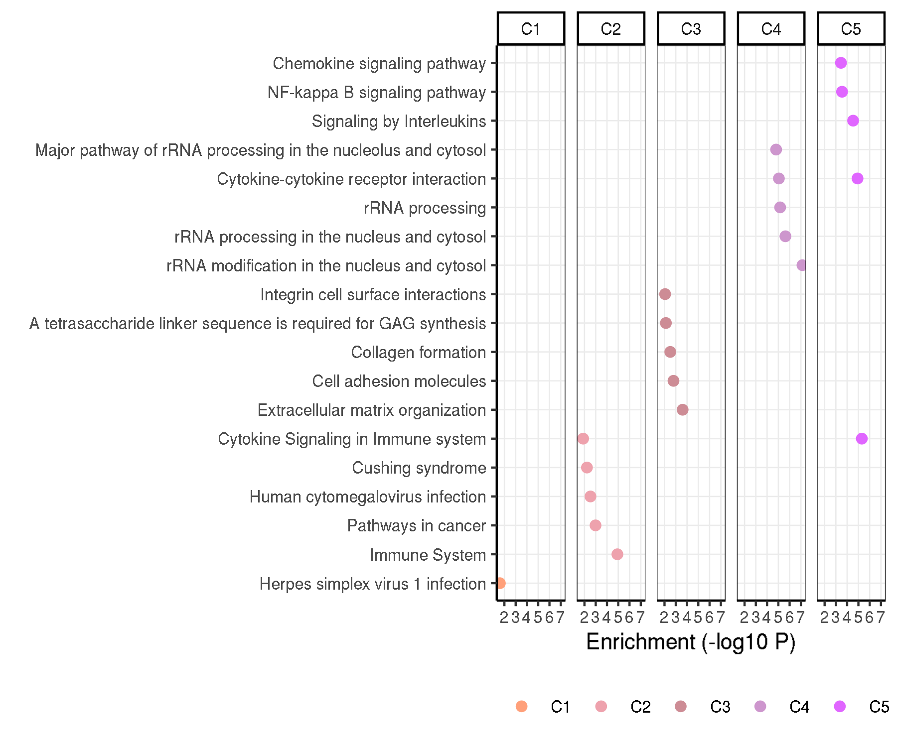
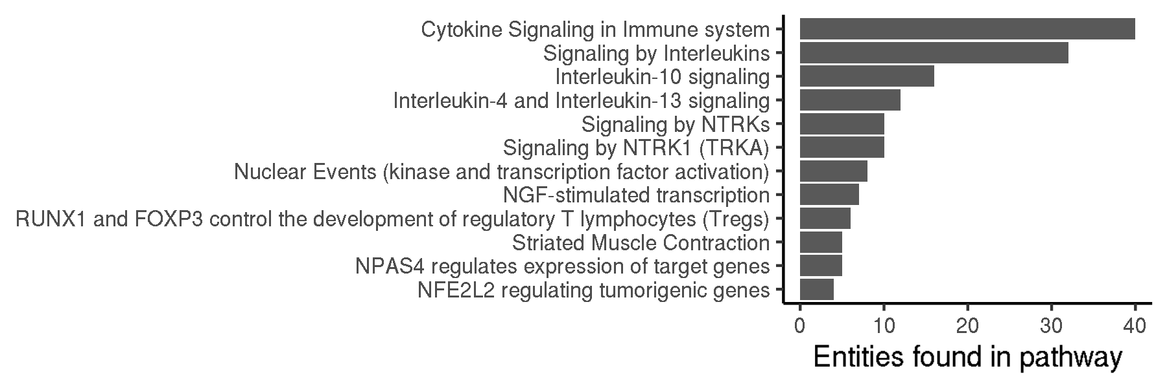
Signaling pathways represented in the CARTEx signature
Contextualizing the CARTEx signature
Enriched pathways by cluster
Enriched pathways in CARTEx
Notes:
Hello world

Slide 8
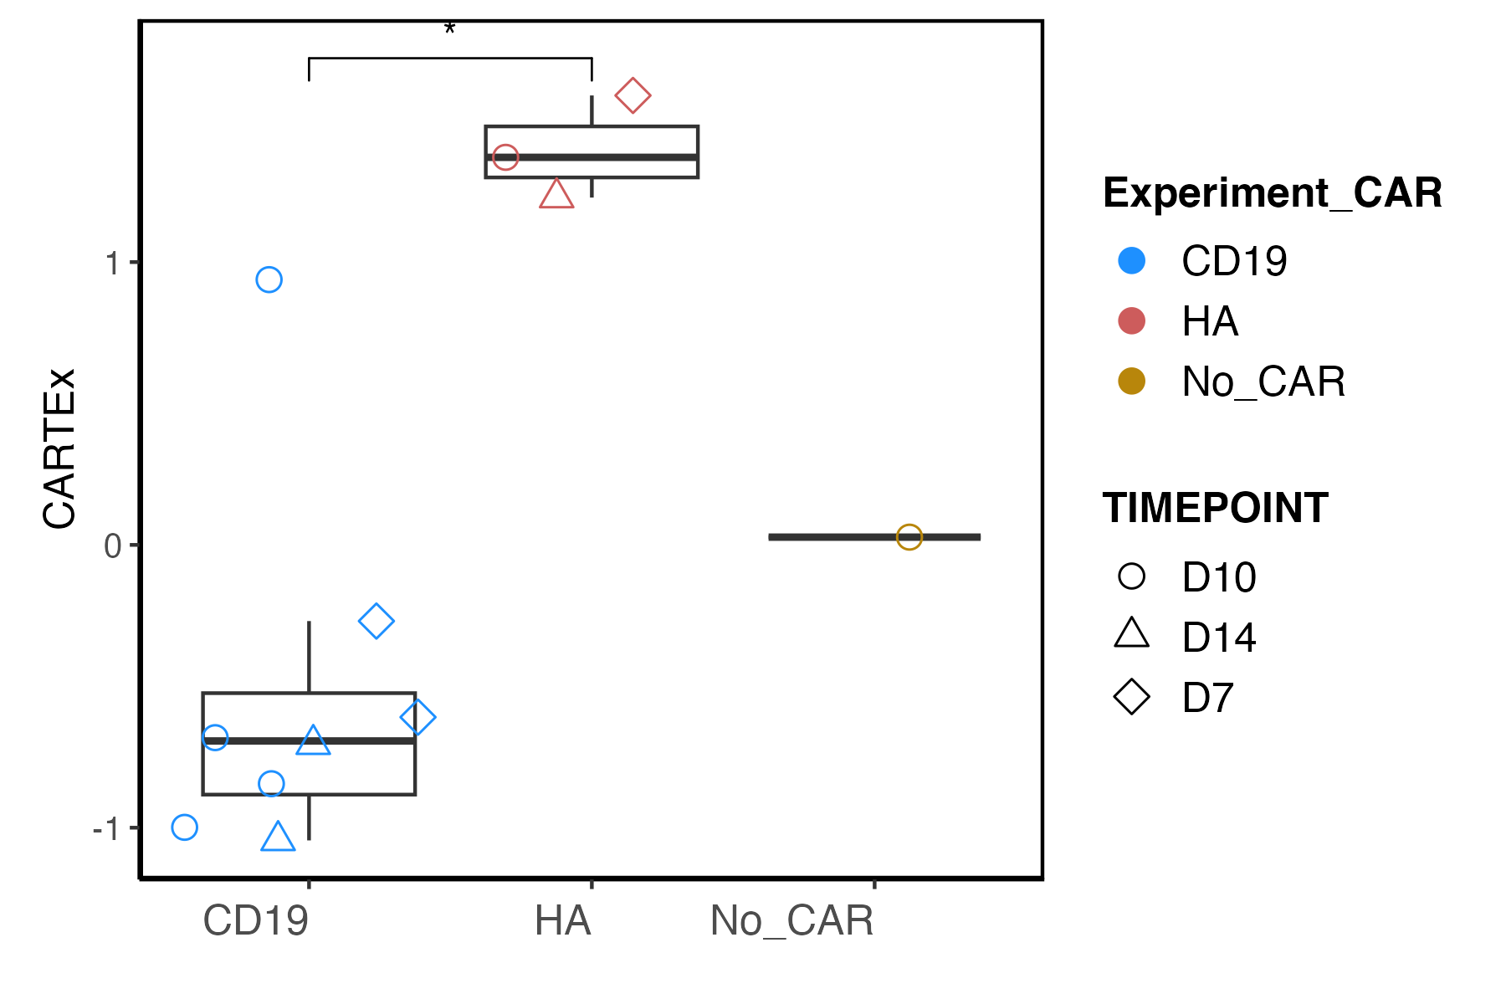
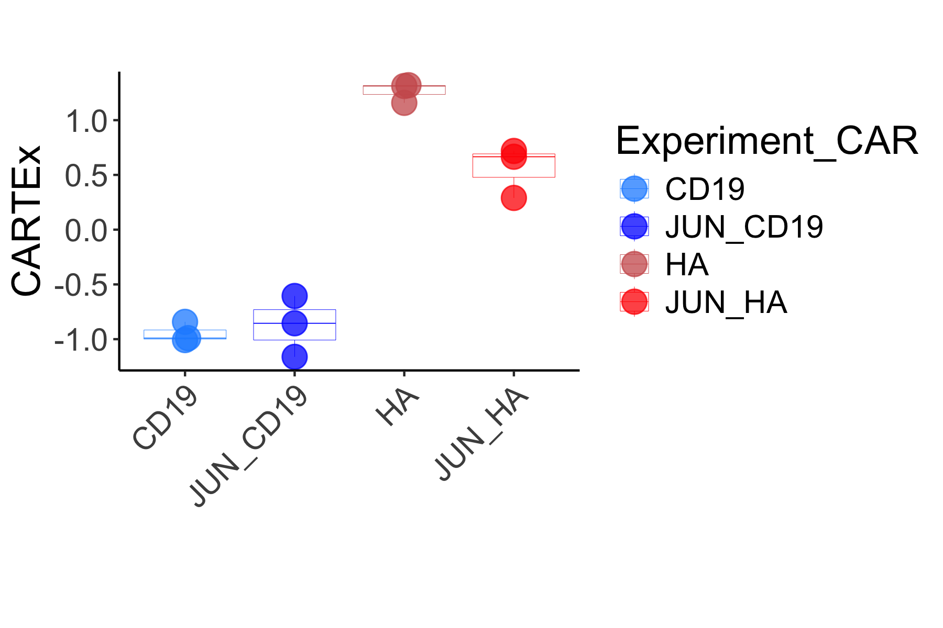
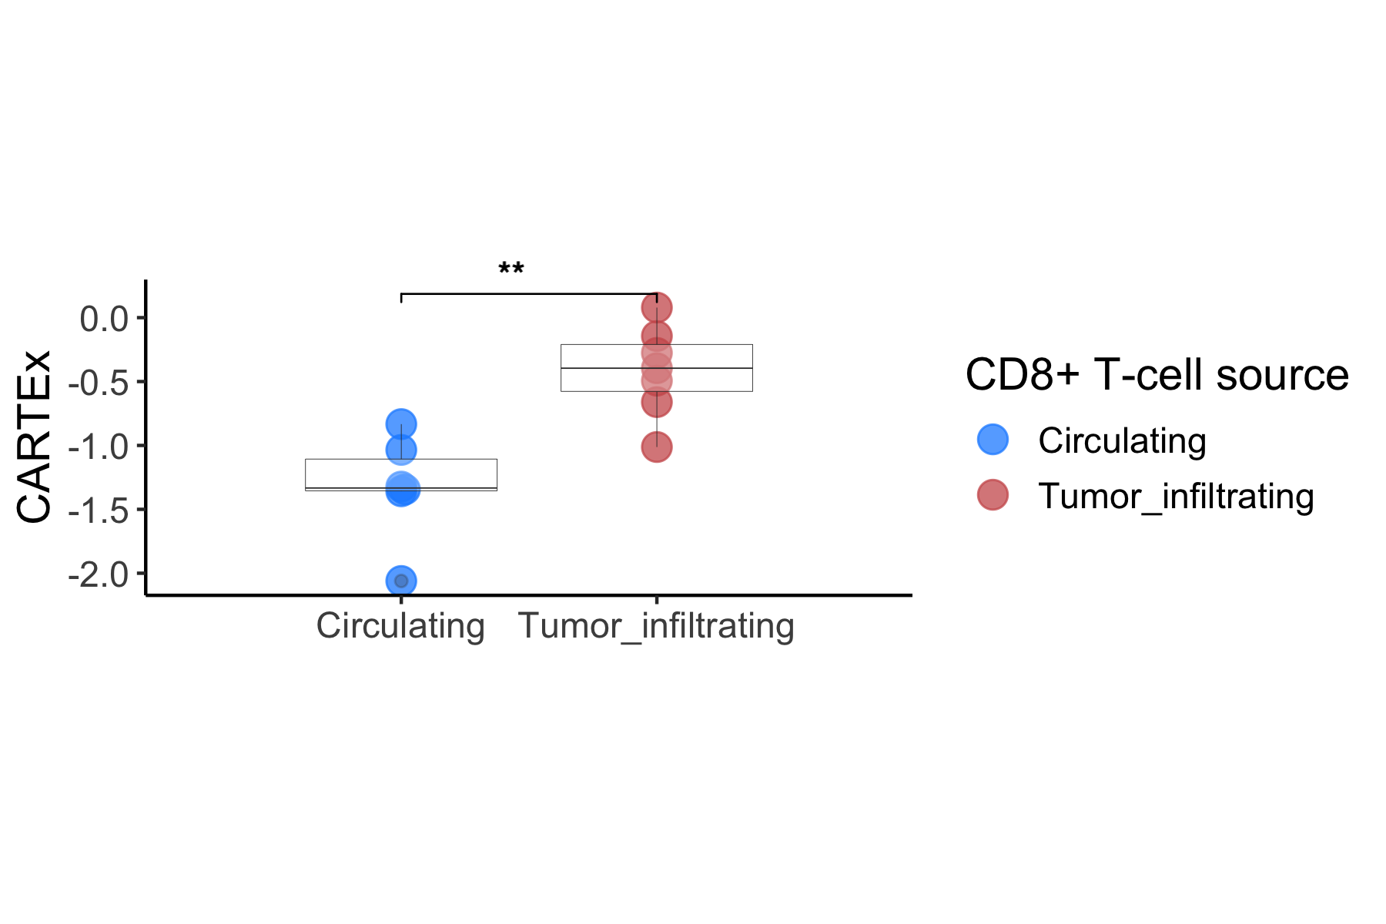
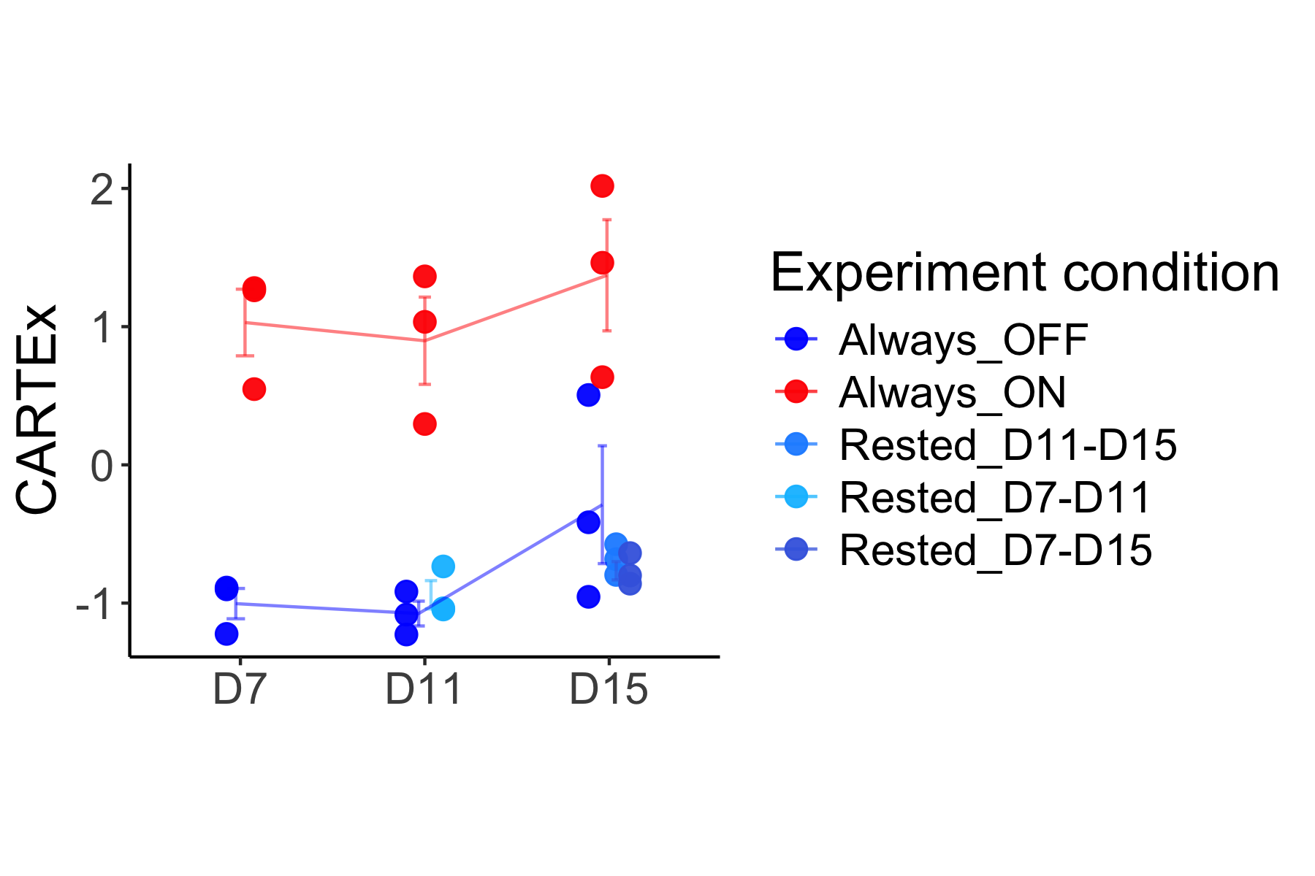
CARTEx scoring of bulk RNA sequencing datasets
Validation of CARTEx signature
Functional vs exhaustion-prone CAR T cells
JUN-overexpression in CAR T cells
Regulatable CAR T cells
Circulating vs TILs
Notes:
Hello world

Slide 9
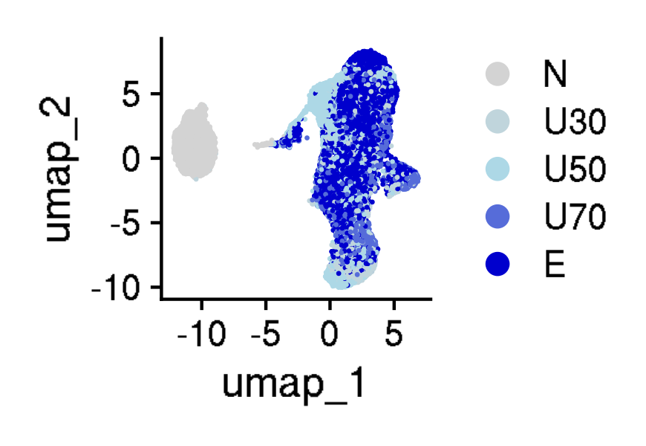
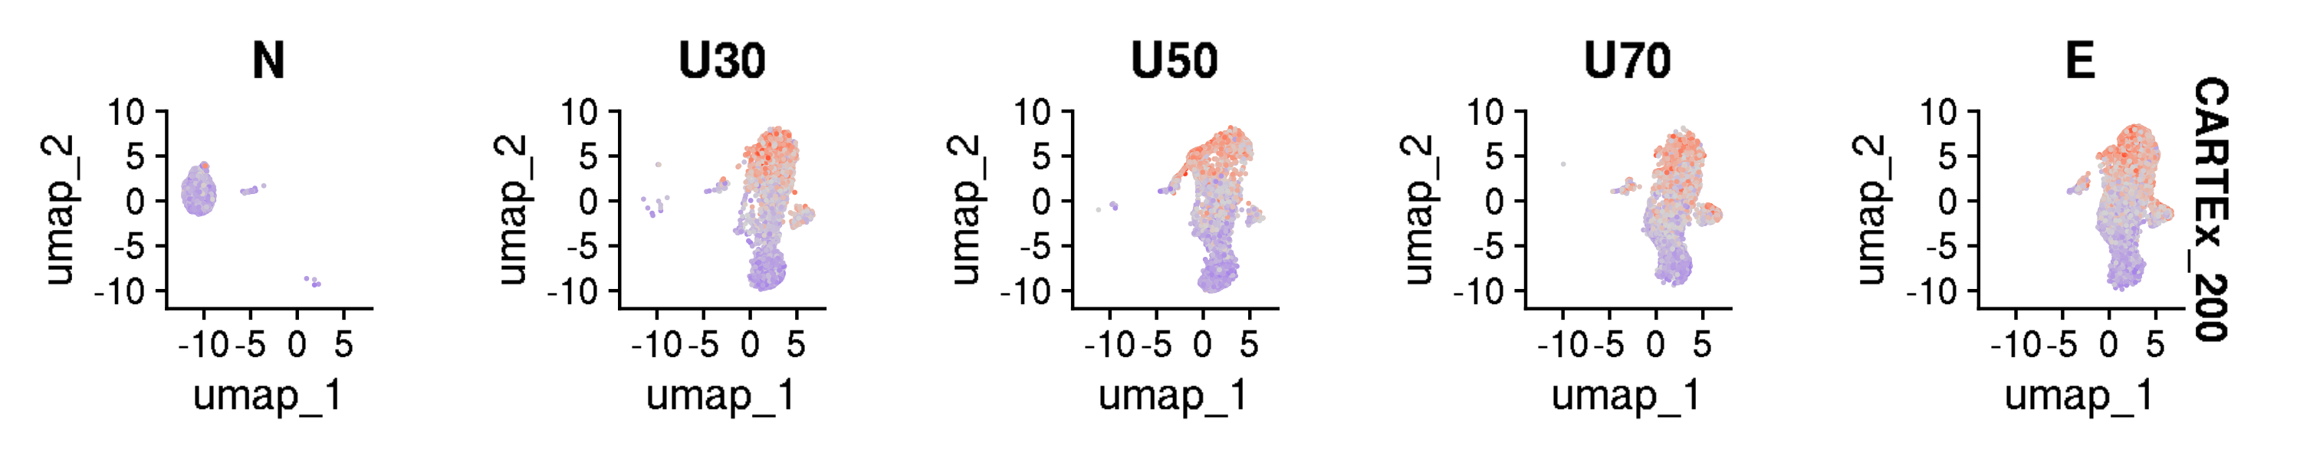
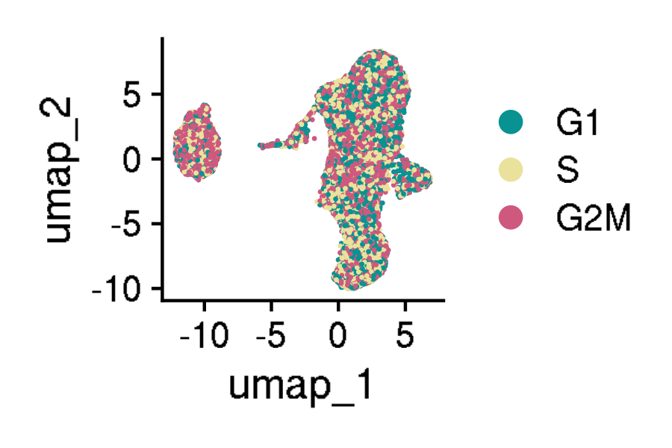
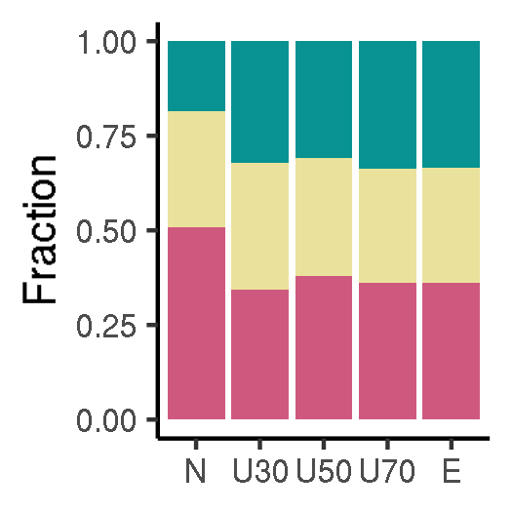
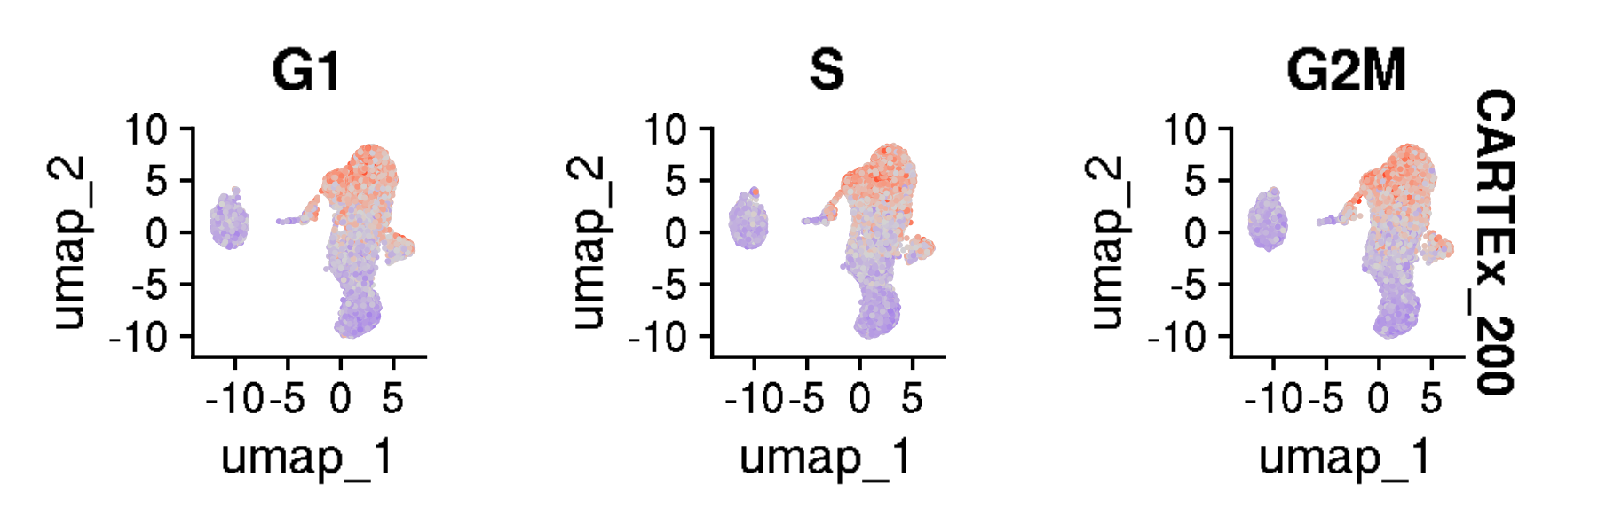
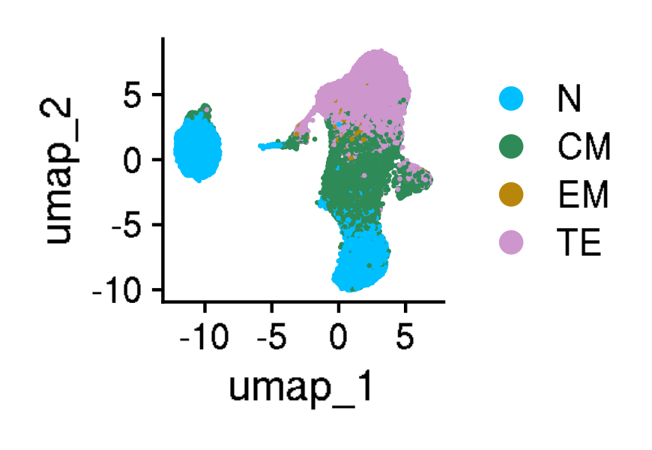
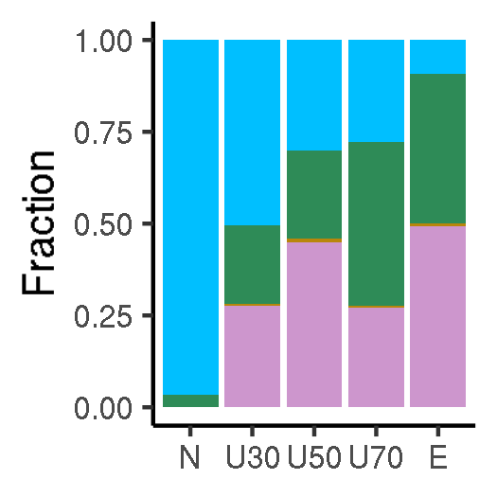
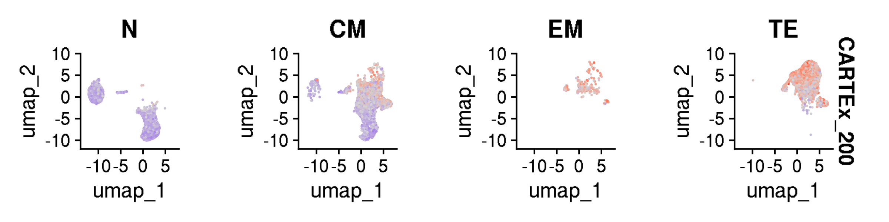
Analysis of cross-sectional aging T cells
GSE136184: 39,937 CD8+ T cells from healthy donors across 9 decades of life
Age group
CARTEx scores split by age group
Cell cycle phase
CARTEx scores split by phase
Cell type differentiation
CARTEx scores split by differentiation
Notes:
Hello world

Slide 10
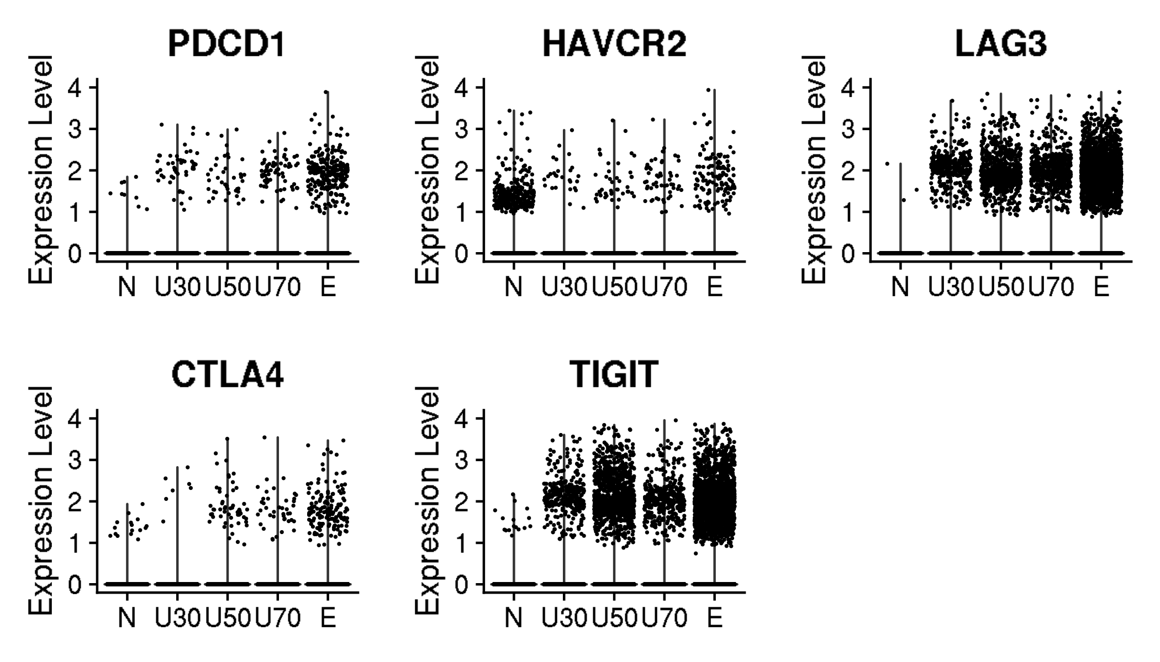
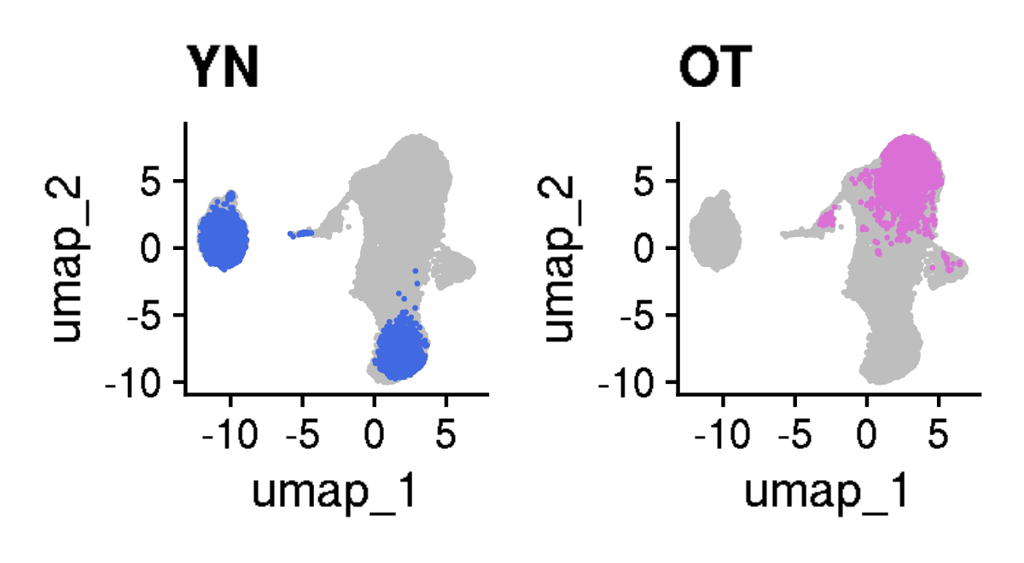
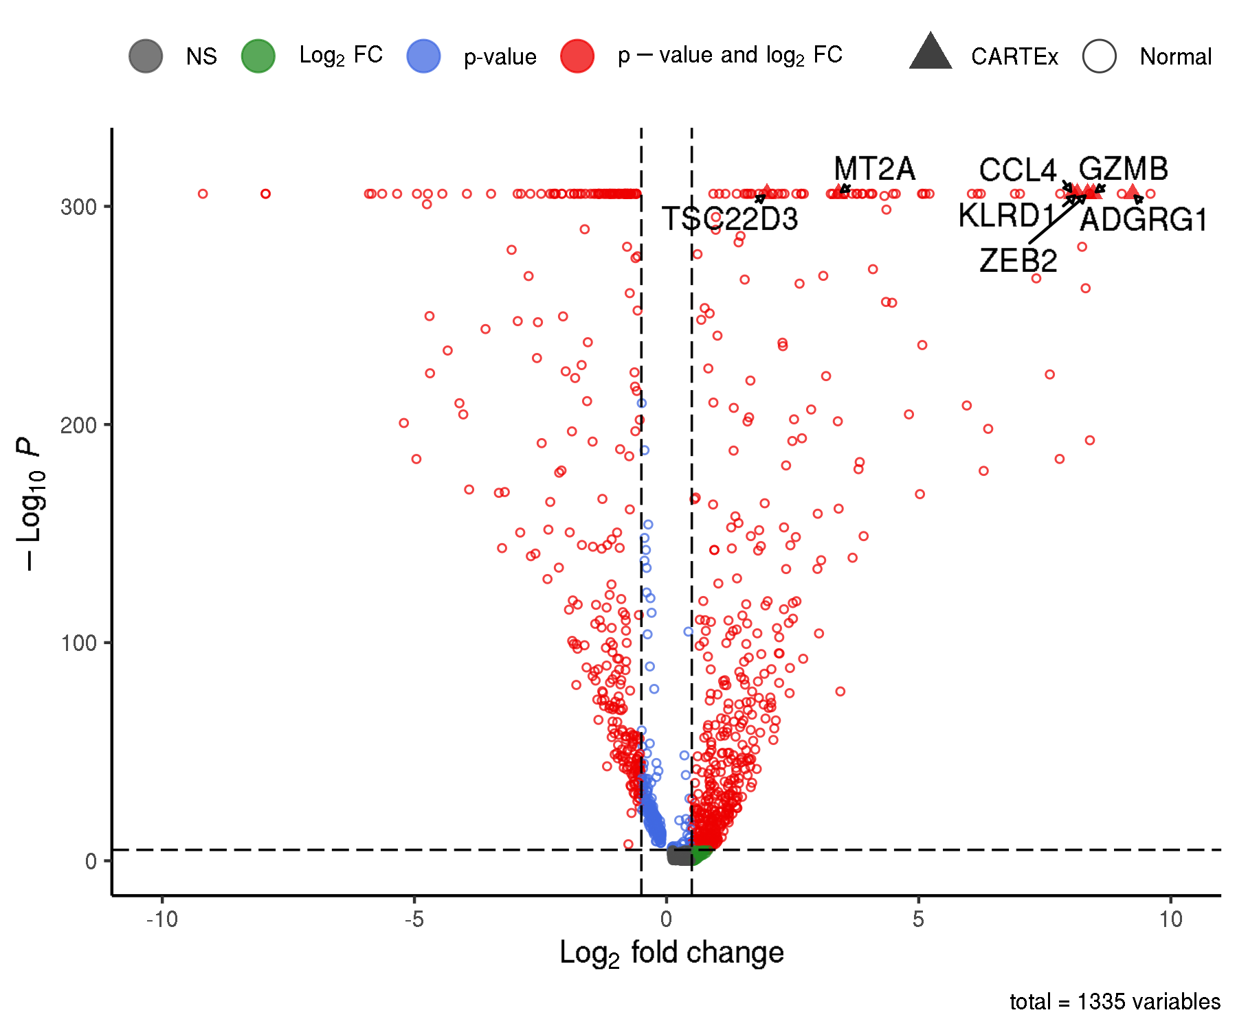
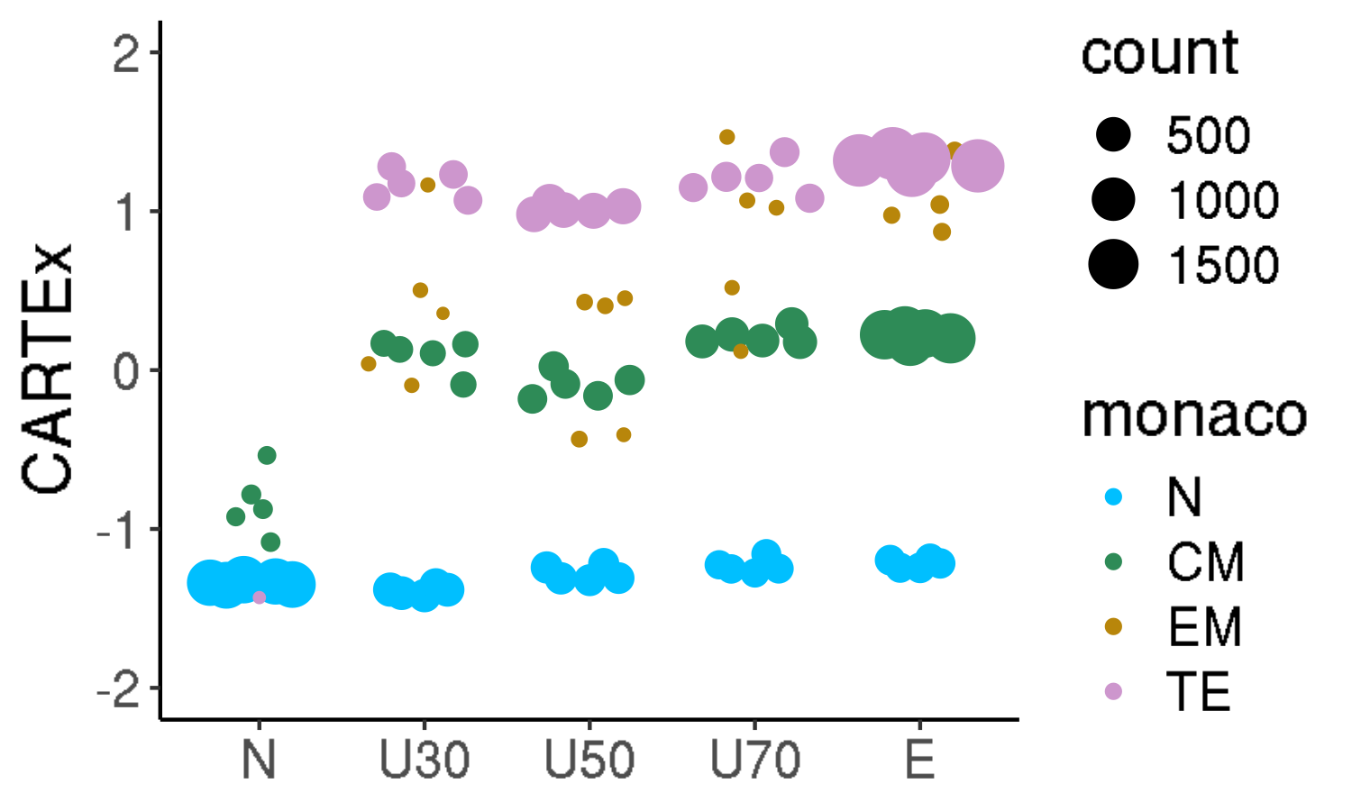
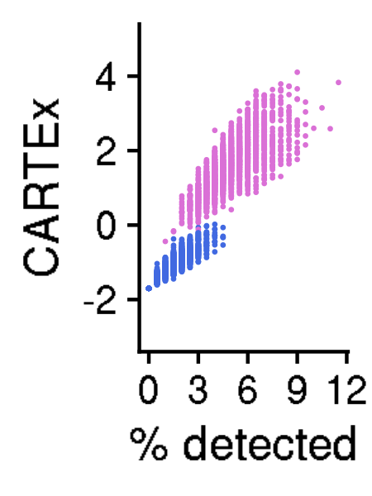
Analysis of 39,937 CD8+ T cells from healthy donors across 9 decades of life
ABC XYZ
Canonical markers of exhaustion
Selected cells for CARTEx markers
Differential gene expression
Pseudo-bulk across differentiation
CARTEx scores for CARTEx markers
Notes:
Hello world

Slide 11
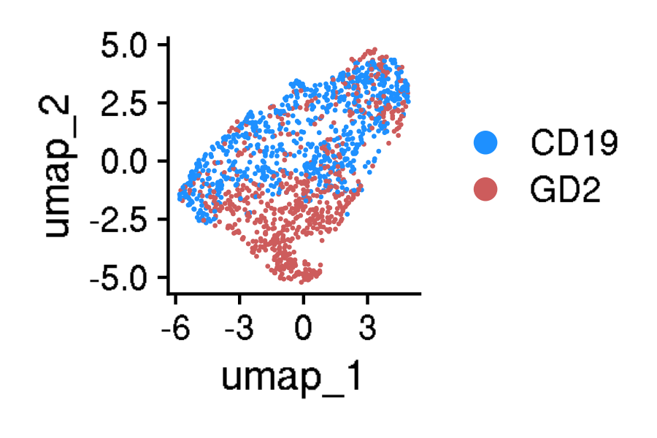
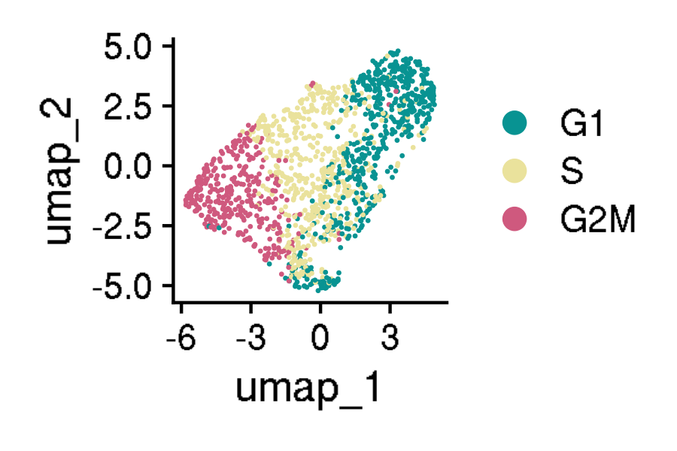
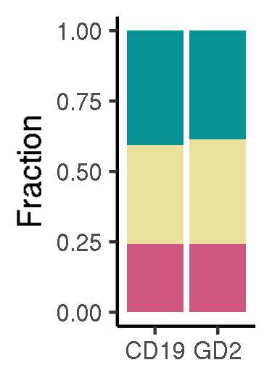
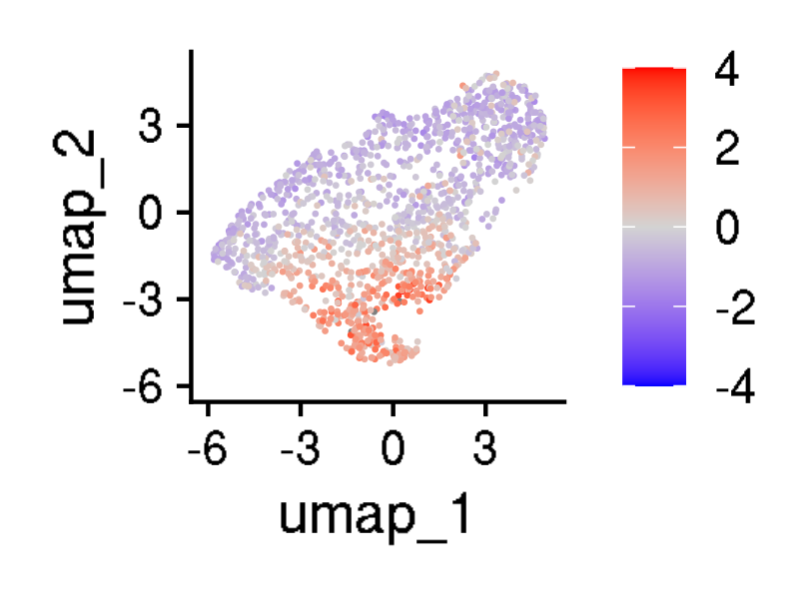
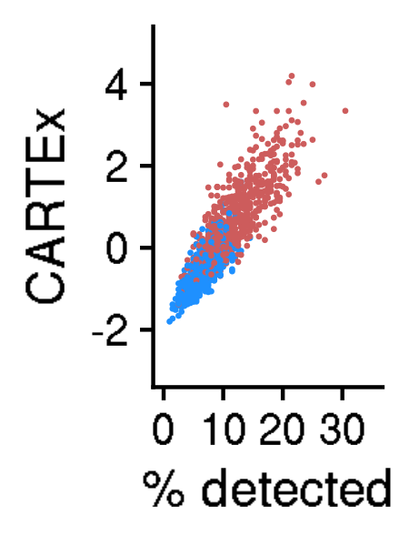
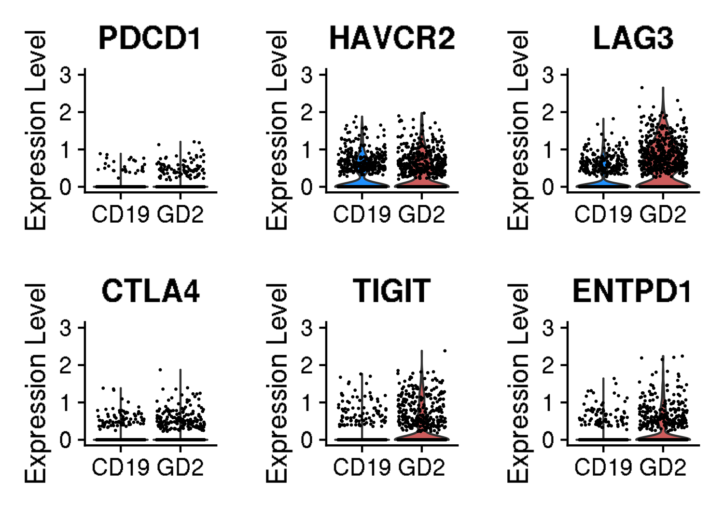
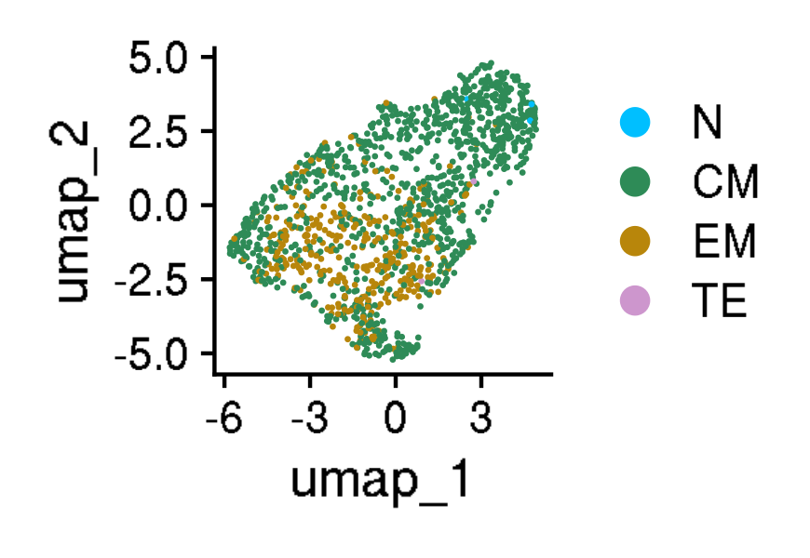
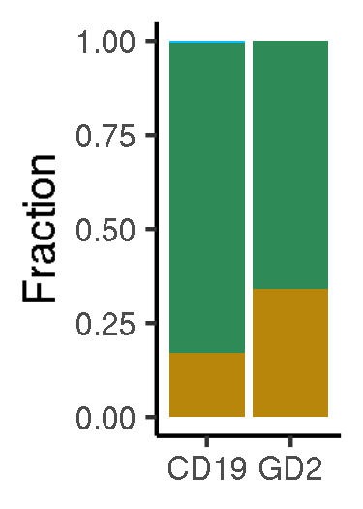
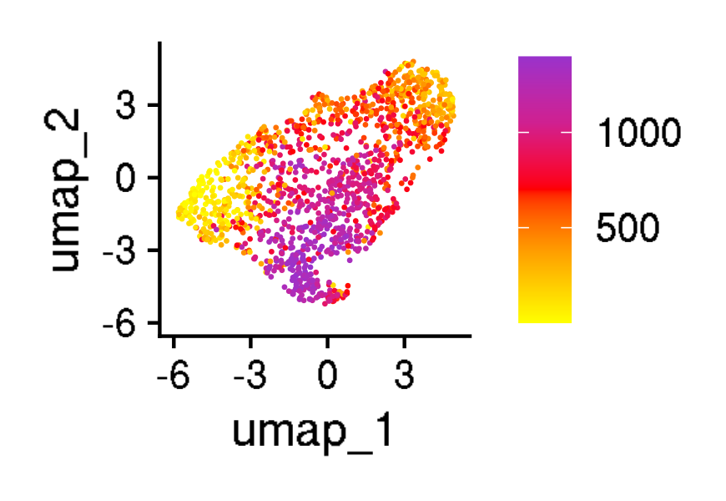
Validation of CARTEx signature in another CAR T cell exhaustion model
GSE136874: 1,397 CD8+ CAR T cells at day 10 of cell culture
Functional vs exhaustion-prone CAR
Cell cycle phase
CARTEx scores
CARTEx detection
Canonical markers of exhaustion
Cell type differentiation
Pseudo-time (DC1 rank)
Notes:
Hello world

Slide 12
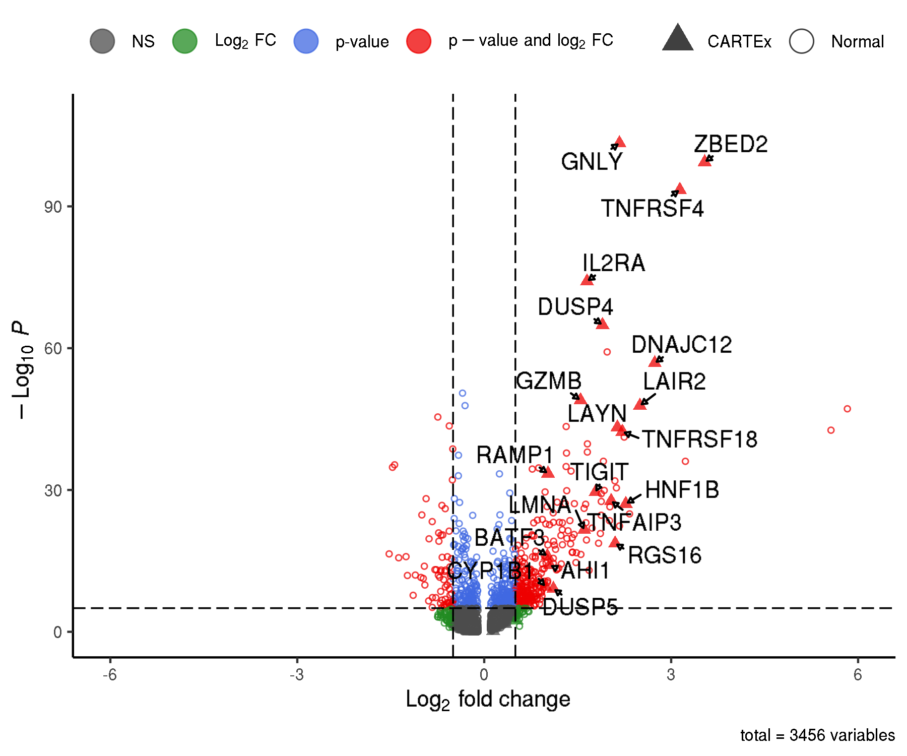


Validation of CARTEx signature in another CAR T cell exhaustion model
GSE136874: 1,397 CD8+ CAR T cells at day 10 of cell culture
Differential gene expression
Pseudo-bulk CARTEx scores
Pseudo-bulk across differentiation
Notes:
Hello world

Slide 13



Validation of CARTEx signature in another CAR T cell exhaustion model
GSE136874: 1,397 CD8+ CAR T cells at day 10 of cell culture
Antigen exposure (diffusion)
Transition (DC1 rank)
CARTEx scores (diffusion)
Notes:
Hello world

Slide 14









Validation of CARTEx signature in another CAR T cell exhaustion model
GSE160160: 13,039 CD8+ mesothelin (MSLN) CAR T cells across 20 days of antigen stimulation
Antigen exposure
Cell cycle phase
CARTEx scores
CARTEx detection
Canonical markers of exhaustion
Cell type differentiation
Pseudo-time (DC1 rank)
Notes:
Hello world

Slide 15



Validation of CARTEx signature in another CAR T cell exhaustion model
GSE160160: 13,039 CD8+ mesothelin (MSLN) CAR T cells across 20 days of antigen stimulation
Differential gene expression
Pseudo-bulk CARTEx scores
Pseudo-bulk across differentiation
Notes:
Hello world

Slide 16



Validation of CARTEx signature in another CAR T cell exhaustion model
GSE160160: 13,039 CD8+ mesothelin (MSLN) CAR T cells across 20 days of antigen stimulation
Antigen exposure (diffusion)
Transition (DC1 rank)
CARTEx scores (diffusion)
Notes:
Hello world

Slide 17











Analysis of T cell activation
GSE126030: 5,434 resting and stimulated CD8+ T from healthy donors
Stimulation status
CARTEx scores split by stimulation
Tissue
CARTEx scores split by tissue
Cell cycle phase
CARTEx scores split by phase
Pseudo-bulk across differentiation
Cell type differentiation
CARTEx scores split by differentiation
Notes:
Hello world

Slide 18









Analysis of T cells in various tissue types
MD Anderson T cell map: 53,757 CD8+ T cells from 16 cancer types
Tissue type
CARTEx scores split by tissue type
Cell cycle phase
CARTEx scores split by phase
Pseudo-bulk across differentiation
Cell type differentiation
CARTEx scores split by differentiation
Notes:
Hello world

Slide 19








Correlation of CARTEx scores with clinical outcomes
GSE120575: 4,619 CD8+ TILs from 32 metastatic melanoma patients receiving checkpoint inhibitors
Clinical response
Cell cycle phase
CARTEx scores
CARTEx detection
Canonical markers of exhaustion
Cell type differentiation
Notes:
Hello world

Slide 20



Correlation of CARTEx scores with clinical outcomes
GSE120575: 4,619 CD8+ TILs from 32 metastatic melanoma patients receiving checkpoint inhibitors
Differential gene expression
Pseudo-bulk CARTEx scores
Pseudo-bulk across differentiation
Notes:
Hello world

Slide 21








Correlation of CARTEx scores with clinical outcomes
GSE151511: 49,962 CD8+ CD19 CAR T cells from infusion products for 24 patients with B cell lymphomas
Clinical response
Cell cycle phase
CARTEx scores
CARTEx detection
Canonical markers of exhaustion
Cell type differentiation
Notes:
Hello world

Slide 22



Correlation of CARTEx scores with clinical outcomes
GSE151511: 49,962 CD8+ CD19 CAR T cells from infusion products for 24 patients with B cell lymphomas
Differential gene expression
Pseudo-bulk CARTEx scores
Pseudo-bulk across differentiation
Notes:
Hello world

Slide 23









Circulating CAR T cells persist with lower CARTEx scores over time
GSE125881: 47,045 CD8+ CD19 CAR T cells across 16 weeks in 4 patients with B cell malignancies
Collection time
Cell cycle phase
CARTEx scores
CARTEx detection
Canonical markers of exhaustion
Cell type differentiation
Pseudo-bulk CARTEx scores
Pseudo-bulk across differentiation
Notes:
Hello world

Slide 24











CARTEx scores correlated with disease severity
GSE153931: 61,583 CD8+ virus-reactive T cells including those with memory response to SARS-CoV-2
Disease severity
CARTEx scores split by disease severity
Virus type
CARTEx scores split by virus type
Cell cycle phase
CARTEx scores split by phase
Pseudo-bulk across differentiation
Cell type differentiation
CARTEx scores split by differentiation
Notes:
Hello world

Slide 25








T cells in STAT3 GOF display exhaustion features
GSE207935: 25,191 CD8+ T cells from patients with STAT3 GOF syndrome
Stimulation and disease status
Cell cycle phase
CARTEx scores
CARTEx detection
Canonical markers of exhaustion
Cell type differentiation
Notes:
Hello world

Slide 26





T cells in STAT3 GOF display exhaustion features
GSE207935: 25,191 CD8+ T cells from patients with STAT3 GOF syndrome
Differential gene expression (Stimulated)
Pseudo-bulk CARTEx scores
Reactome pathway analysis
Differential gene expression (Rested)
Pseudo-bulk across differentiation
Notes:
Hello world

Slide 27









Correlation of CARTEx scores with disease severity
GSE146264: 3,342 CD8+ T cells from the skin of 11 psoriatic patients and 5 healthy donors
Disease severity
Cell cycle phase
CARTEx scores
CARTEx detection
Canonical markers of exhaustion
Cell type differentiation
Pseudo-bulk across differentiation
Notes:
Hello world

Slide 28










T cell exhaustion and BEACH domain deficiencies
GSE196606: 8,118 CD8+ T cells from patients with BEACH domain deficiencies
Mutation status
Cell cycle phase
CARTEx scores
CARTEx detection
Canonical markers of exhaustion
Cell type differentiation
Pseudo-bulk scores
CTLA4 expression
Notes:
Hello world

Slide 29










T cell exhaustion and Parkinson's disease
Zenodo3993994: 28,105 CD8+ T cells from patients with Parkinson's disease
Disease status
Cell cycle phase
CARTEx scores
CARTEx detection
Canonical markers of exhaustion
Cell type differentiation
Pseudo-bulk scores
Differential gene expression
Notes:
Hello world

Slide 30






T cell exhaustion and Parkinson's disease
Zenodo3993994: 28,105 CD8+ T cells from patients with Parkinson's disease
Disease status (diffusion)
CARTEx scores (diffusion)
Transition plot with differentiation
Cell type differentiation (diffusion)
Pseudo-time (DC1 rank)
Transition plot with CARTEx scores
Notes:
Hello world

Slide 31
Appendix
Appendix
Notes:
Hello world

Slide 32

Reactome analysis - pathway coverage
Notes:
Hello world

Slide 33


Late differentiation subsets of exhausted T cells
Daniels et al.
Notes:
Hello world

Slide 34








GSE136874: Functional vs exhaustion-prone CAR T cells
Appendix
CARTEx
Activation
Anergy
Senescence
Stemness
NK-like
LCMV
BBD
PD1
Notes:
Hello world

Slide 35








GSE136874: Functional vs exhaustion-prone CAR T cells
Appendix
LCMV
NK-like
BBD
PD1
Notes:
Hello world

Slide 36











GSE136874: Functional vs exhaustion-prone CAR T cells
Appendix
CARTEx
Split by CAR
Tex-Term
Split by CAR
Split by cell type differentiation
Split by cell type differentiation
Stress response
Split by CAR
Tex-KLR
Split by CAR
Split by cell type differentiation
Split by cell type differentiation
Notes:
Hello world

Slide 37








GSE160160: Continuous antigen exposure of CAR T cells
Appendix
CARTEx
Activation
Anergy
Senescence
Stemness
NK-like
LCMV
BBD
PD1
Notes:
Hello world

Slide 38








GSE160160: Continuous antigen exposure of CAR T cells
Appendix
LCMV
NK-like
BBD
PD1
Notes:
Hello world

Slide 39

GSE126030: 5,434 resting and stimulated CD8+ T from healthy donors
Appendix
Pseudo-bulk CARTEx scores
Pseudo-bulk across differentiation
Notes:
Hello world

Slide 40



MD Anderson T cell map: 53,757 CD8+ T cells from 16 cancer types
Appendix
Canonical markers of exhaustion
Pseudo-bulk across differentiation
CARTEx and stress response signature comparison
Stress response scores split by tissue type
Notes:
Hello world

Slide 41








GSE120575: 4,619 CD8+ TILs from 32 metastatic melanoma patients receiving checkpoint inhibitors
Appendix
CARTEx
Activation
Anergy
Senescence
Stemness
NK-like
LCMV
BBD
PD1
Notes:
Hello world

Slide 42








GSE151511: asdasd
Appendix
CARTEx
Activation
Anergy
Senescence
Stemness
NK-like
LCMV
BBD
PD1
Notes:
Hello world

Slide 43








GSE125881: 47,045 CD8+ CD19 CAR T cells across 16 weeks in 4 patients with B cell malignancies
Appendix
CARTEx
Activation
Anergy
Senescence
Stemness
NK-like
LCMV
BBD
PD1
Notes:
Hello world

Slide 44








GSE207935: 25,191 CD8+ T cells from patients with STAT3 GOF syndrome
Appendix
CARTEx
Activation
Anergy
Senescence
Stemness
NK-like
LCMV
BBD
PD1
Notes:
Hello world

Slide 45











GSE207935: 25,191 CD8+ T cells from patients with STAT3 GOF syndrome
Appendix
CARTEx
Split by stimulation-disease status
Tex-Term
Split by stimulation-disease status
Split by cell type differentiation
Split by cell type differentiation
Stress response
Split by stimulation-disease status
Tex-KLR
Split by stimulation-disease status
Split by cell type differentiation
Split by cell type differentiation
Notes:
Hello world

Slide 46












GSE207935: 25,191 CD8+ T cells from patients with STAT3 GOF syndrome
Appendix
CARTEx
Split by stimulation-disease status
Tex-Term
Split by stimulation-disease status
Split by cell type differentiation
Split by cell type differentiation
Stress response
Split by stimulation-disease status
Tex-KLR
Split by stimulation-disease status
Split by cell type differentiation
Split by cell type differentiation
Notes:
Hello world

